Slide 1


Vivekanand Education Society’s Institute of Technology, Computer Department
Human Team Foundation
Team details
Team Name: CodeOverflow
Team Member: Bhavesh Lohana

Slide 2
Abstract
For this problem, I have decided to use the minimalist approach. As its an NGO website, it would be better to not clutter it with many technologies and use with the reliable ones. Further, to increase the reach, effective SEO would be used. The website would strictly revolve around the chief aim of the Human Team Foundation. And, an admin page for the ease of adding and editing the events articles quickly.

Slide 3
Abstract(Continued)
Home: Organised sections, proper navbar and footer.
Events: Collapsible future and past events.
About Us: Founder details, member information and location.
Donate: Multiple ways of donation with transaction saved in database.
Sponsors: Dedicated page for sponsors so as to encourage more audience to be featured.

Slide 4
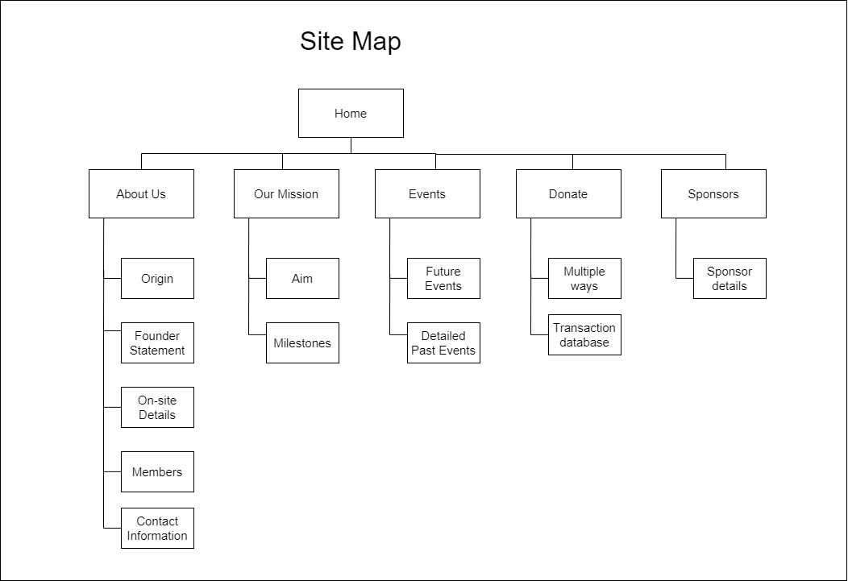
Proposed Architecture
(Diagram/Example/Flowchart/Etc)

Slide 5
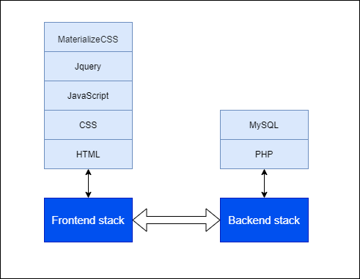
Technology Stack
LAMP STACK

Slide 6
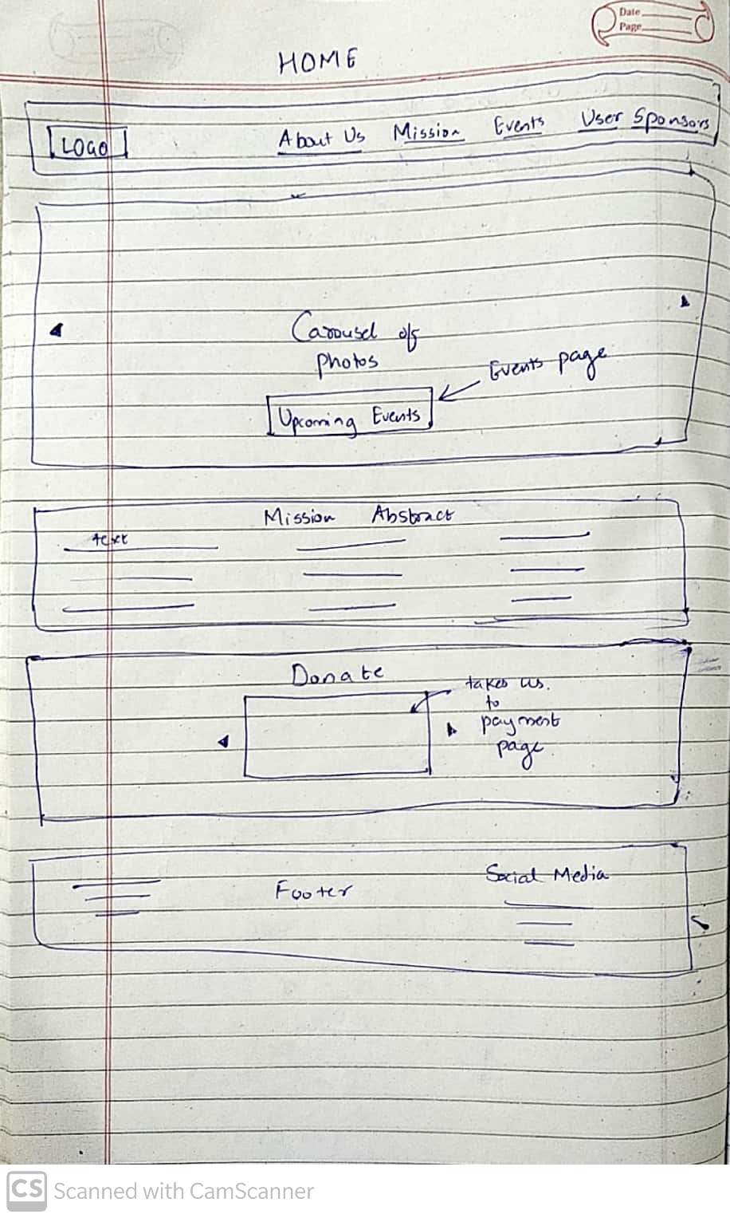
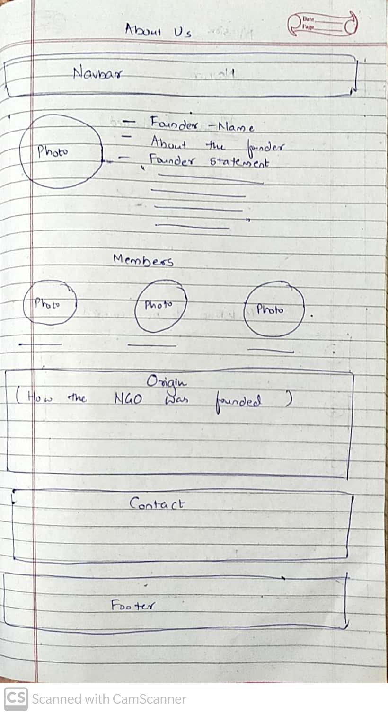
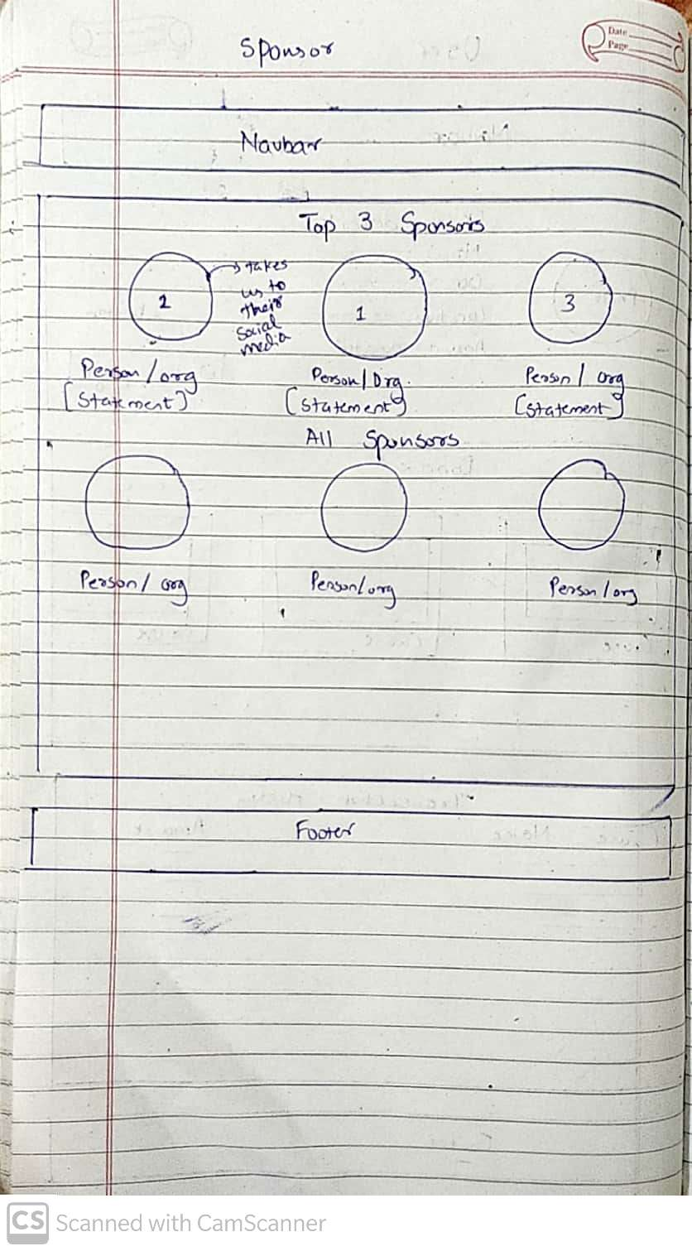
Prototype

Slide 7
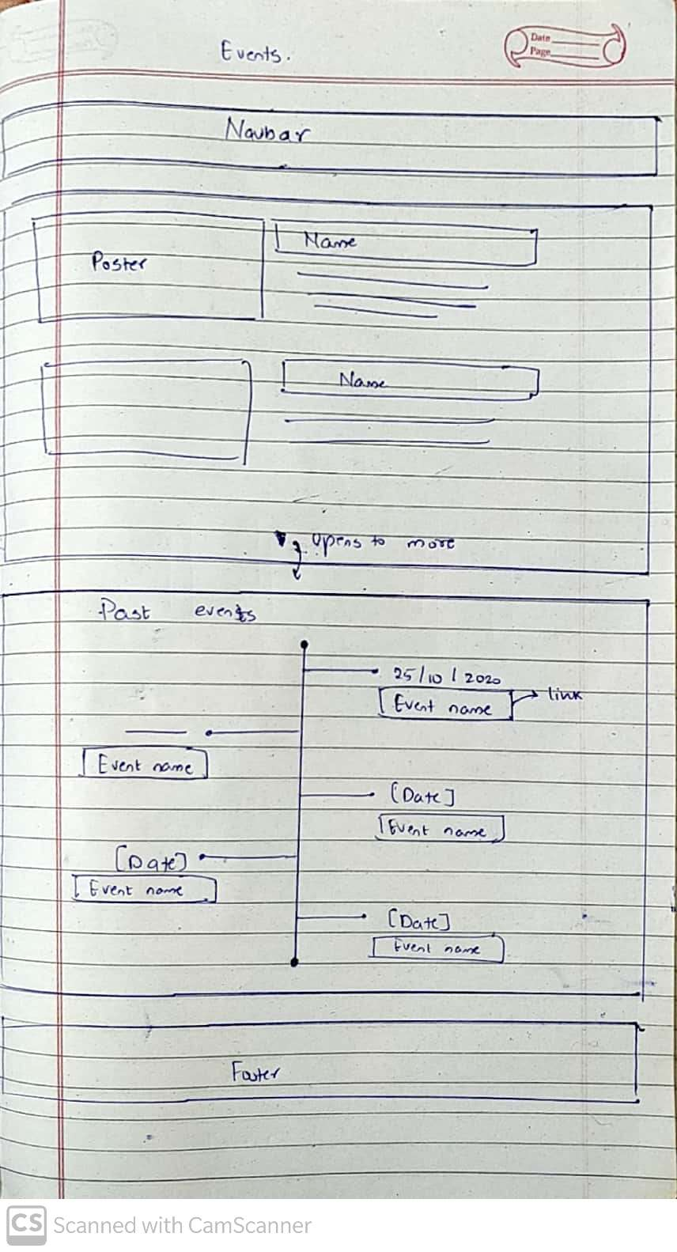
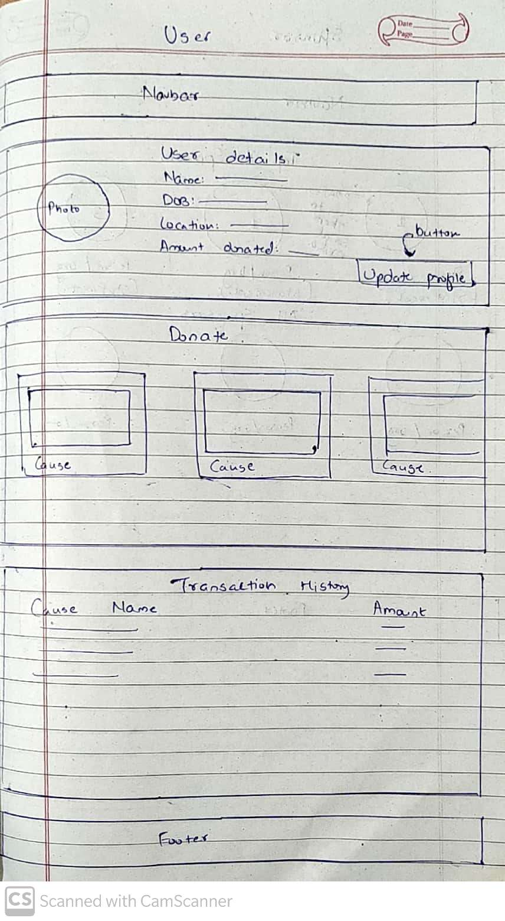
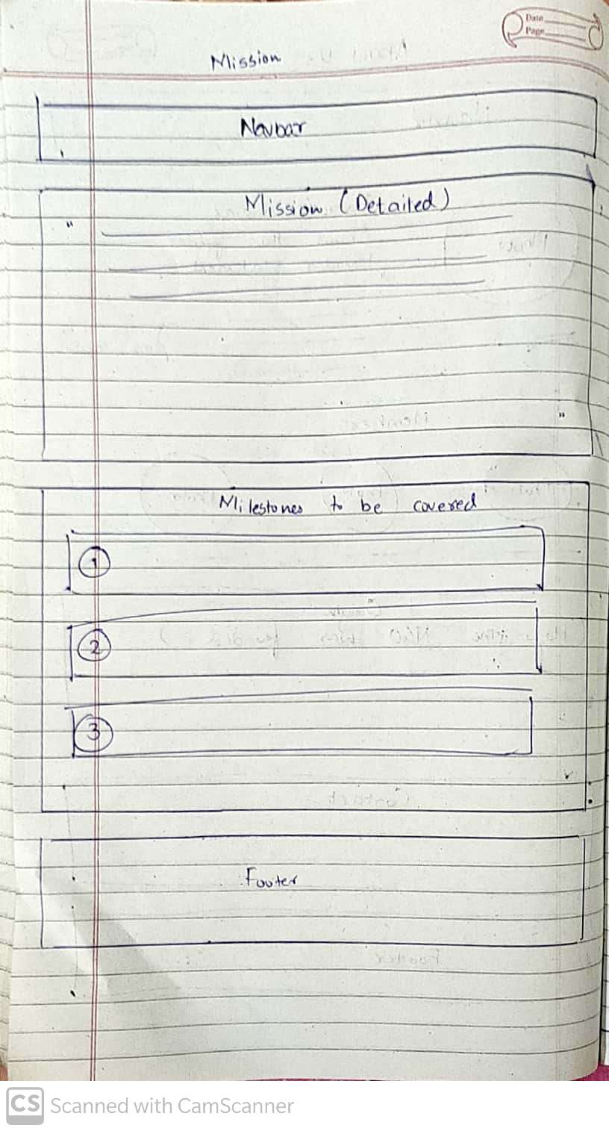
Prototype(Continued)

Slide 8
What more could be added?
SMTP Mail - To send a acknowledgment mail to user after they donate.
AI Chatbot - To solve queries quickly.
User Login System - To make the donation process for the user hassle-free by preventing them from adding same details again
Admin Login – To supervise the entire working of the website
Build an app using the website.
FAQ Page

Slide 9
Conclusion
The end result will be a website which lets everything transparent between the foundation and its user. The events, sponsors page, user details, transaction will be readily available to both the user and the foundation. The website would be much faster using LAMP stack.

Slide 10
Github Repository Link
https://github.com/bhaveshlohana/humanteamwebsite

